Slide 1
Store Transaction Data Lake using Databricks
Patrick Artac, Allie Schneider, Francis Villamater, Zoe Weiner
INFO 607 - Spring 2023
Notes:
Allie

Slide 2
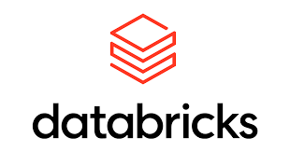
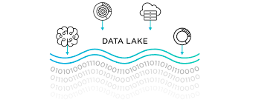
Project Goals
Gain hands-on experience
Gain insights from transactional data
Notes:
Allie

Slide 3
Business Questions
Sales
How are sales trending over time?
What are the top selling products?
Which products have declining sales?
How do sales vary across different store locations?
Notes:
Allie

Slide 4
Business Questions
Pricing
How does pricing affect sales volume?
Can we identify optimal price points for different products?
What is the price elasticity of demand for various items?
Notes:
Allie

Slide 5
Business Questions
Demand Forecasting
Can we prediction future demand for different products or categories?
Can historical transaction data improve demand forecasting accuracy?
Due to the limitations of our dataset, we were not able to answer the pricing and demand forecasting specific business questions. However, these questions serve as a great example of business questions that can be answered by a live data lake implemented in the enterprise version of Databricks.
Notes:
Allie

Slide 6
Data Used
Attribute | Description
Month | Month ID (M1, M2, M3)
Storecode | Store Code (P1, P2, …, P10)
Qty | Sales Unit
Value | Sales Value
Grp | Category
Sgrp | Subcategory
Ssgrp | Sub Subcategory
CMP | Company / Manufacturer
Mbrd | Mother Brand
Brd | Brand
Store transaction data downloaded from Kaggle.com as a csv file
A Kaggle user acquired this data from Nielsen Holdings
The dataset contains brand level data for 10 stores for 3 months
The transaction data is structured data
Notes:
Allie
Nielsen Holdings is a data and market measurement firm conducting independent measurement and generating data for fast-moving consumer goods, consumer behavior, and media.

Slide 7
Data Quality and Pre-Processing
We have loosely implement ETL:
Extracted our dataset from Kaggle.com
Loaded the data into a dataframe in Databricks
Transformed the data from a dataframe to a data table in Databricks to create our Data Lake
Notes:
Zoe

Slide 8
Data Quality and Pre-Processing
Pre-Processing
The store transaction dataset required a bit of pre-processing:
0 and NULL values encountered - 0’s removed from dataset
Validating data type correctness
The distributions are left untouched to maintain the original characteristics of the dataset and prevent any transformations from skewing the original data
Notes:
Zoe
We then performed a SQL query to check the dataset for ‘0’ values in the 'qty' and 'value' columns. Filtering out rows with ‘0’ values was essential to exclude insignificant data points from future analyses. By removing these rows we ensured that further analysis was based on meaningful and relevant data. (Pre-Pro 2)
We looked at it cumulatively so that is why we removed the 0’s - it would be different if we were looking at it per day.
We then created a new table, "sales_data_3," that excluded rows with ‘0’ values in 'qty' or 'value'. This filtered dataset provided us a cleaner and more focused subset (Pre-Pro 3). By eliminating rows with ‘0’ values, we found that we could avoid skewing calculations and obtain more accurate insights into the sales transactions. We had to modify the data types of the 'qty' and 'value' columns to decimal (10,0) in the "sales_data_3" table for more accurate numerical calculations. We also dropped the original 'qty' and 'value' columns from the "sales_data_3" table to remove columns with incorrect data types. Doing so reduced clutter in the dataset by retaining only the columns with the correct data types.
When we first looked at whether or not there were 0’s - it came back with like 1000 or so
Had to remove the 0’s multiple times to make sure they were all gone.

Slide 9
Data Challenges
Limitations:
Lack of live data for real-time data analysis
Lack of mixed data structures
Limited transaction time frames
Notes:
Zoe
While implementing a data lake using Databricks for this project, we encountered a couple of issues. Firstly, we were unable to incorporate different data structures. Our store transaction dataset consists of structured data in a tabular form. It would have been beneficial to explore how Databricks handles, manages, and integrates unstructured or semi-structured data into our data lake. This would have provided insights into the versatility of Databricks in handling diverse data structures.
Another challenge we faced during the project was the absence of live data for real-time updates to our data lake. One of the major advantages of storing transactional data, like ours, in a data lake is the ability to access and manage real-time data. However, as we are not an actual store with daily transactions, we were unable to fully experience the functionality of a Databricks data lake in handling and processing regularly updated real-time data.
Despite these limitations, our experience with Databricks in implementing a data lake was overall positive, and we were able to gain valuable insights and perform meaningful analysis using the available tools and functionalities.

Slide 10
Data Lake vs Simple Relational Database
Data lake provides more flexibility from a data storage and access standpoint
Easily able to add data to our data lake as new transactions occur
Easily able to access all of the transaction data
Holds different data types: structured, semi-structured, unstructured
Data lake can support data analysis tools
Allows the ability to analyze the data to provide insight and knowledge to the leadership of the business
Allows for collaboration amongst various team members from data scientists to data engineers
Data lake is able to handle large volumes of data
Many new transactions are added to the data every day that the store is open
Velocity of data is high
Data lake supports near real-time data ingestion, processing, machine learning, and AI for streaming data
Notes:
Zoe
In summary, a data lake is suited for storing large volumes of raw, diverse data for exploratory analysis and advanced analytics, while a simple relational database is more suitable for transactional processing, structured data storage, and efficient querying/reporting in smaller-scale scenarios. The choice between the two depends on the specific requirements, data characteristics, and use cases of the organization or project at hand.

Slide 11
Data Lake Benefits
Collaboration: provides a workspace that allows teams to work together on data focused projects
Automatic Cluster Management: Databricks can manage cluster usage based on workload/user demands
Unified Analytics Platform: allows for a wide range of data sources to be ingested, unstructured, semi-structured, and structured data as well as real-time machine-generated data and streaming data
Management Services: numerous solutions for overseeing projects on its platform
High Scalability: can process large volumes of data in real-time and meet the needs of even enterprise-level workloads
Security: capabilities for data encryption, network isolation, identity and access management/tracking, creating an audit trail for data throughout its lifecycle
Notes:
Zoe

Slide 12
Main Methods Employed
Our dataset is stored in our data lake using a parquet format
A parquet format is a columnar storage format that is optimized for big data processing frameworks like Hadoop and Spark. It stores data in a compressed format that allows for efficient querying and analysis of large datasets.
Notes:
Zoe First, we leveraged the Parquet format for effective storage and retrieval of the data. By grouping data into columns, Parquet, a columned storage file format, helped to speed up query performance for our analysis.
To load and manipulate the dataset, we utilized Python, which provided us a versatile environment for data manipulation, allowing us to load the dataset into a dataframe and perform various data transformations, filtering, and computations. Additionally we leveraged various SQL queries to conduct our analysis on our dataframes. We were able to formulate specific queries and draw relevant transactional data from the dataset such as (Product x Store), (Product x Store x Sales) (Product x Store x Cost) etc. SQL's straightforward syntax and flexibility allowed us to collect, filter, join, and analyze the data in a structured and effective manner.
By combining the capabilities of Parquet, Python, and SQL, we were able to do a full analysis of the Store Transaction dataset. The Parquet format optimized our data storage, Python facilitated data manipulation and transformation, and SQL queries enabled us to extract/filter the desired insights from our dataset. We were able to identify patterns, trends, and relationships in the data using these techniques, which helped us gain a better understanding of the dynamics of store transactions and support defensible decision-making.

Slide 13
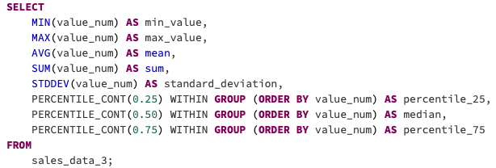
Code & Results - Descriptive Statistics
Notes:
Francis

Slide 14
Code & Results - Descriptive Statistics
Metric | ‘Qty_num’ | ‘Value_num’ | ‘Unit_value’
Minimum Value | 1 | 1 | 0.50
Maximum Value | 641 | 24,185 | 1069.00
Mean | 21.28 | 384.41 | 40.87
25th Percentile | 3 | 68 | 9.67
Median | 8 | 165 | 19.80
75th Percentile | 23 | 378 | 47.82
Notes:
Francis

Slide 15
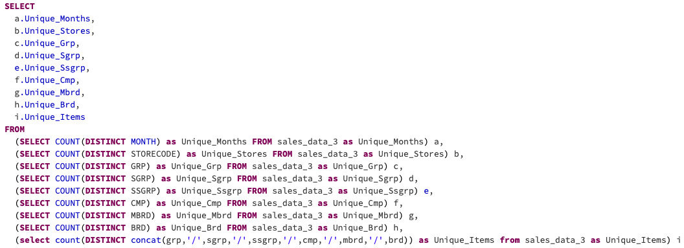
Code & Results - Descriptive Statistics (cont’d)
Variable | Months | Stores | Grp | Sgrp | Ssgrp | Cmp | Mbrd | Brd | Unique Items
Count | 3 | 10 | 80 | 173 | 238 | 471 | 766 | 1,444 | 1,904
Notes:
Francis

Slide 16
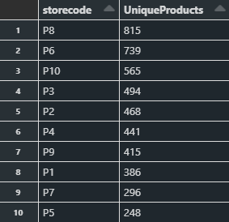
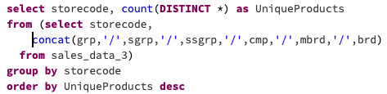
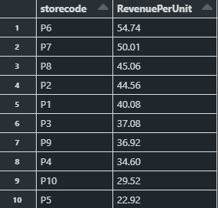

Code & Results - Cumulative
Notes:
Francis

Slide 17
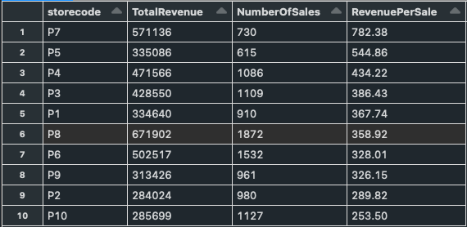
Code & Results - Cumulative (cont’d)
Notes:
Francis

Slide 18
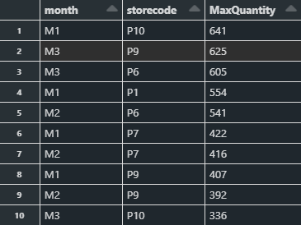

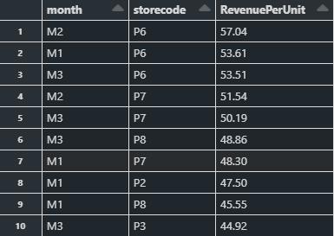

Code & Results - Monthly
Notes:
Francis

Slide 19
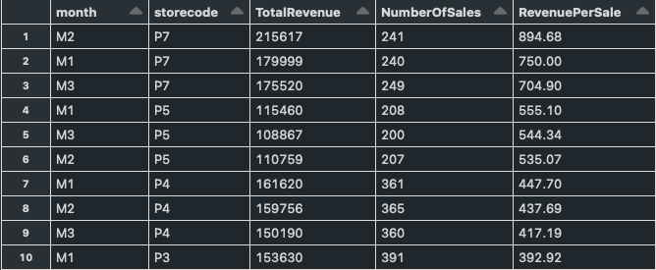
Code & Results - Monthly (cont’d)
Notes:
Francis

Slide 20
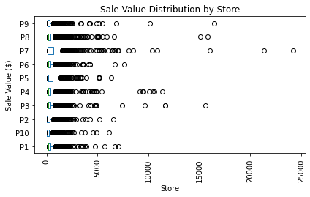
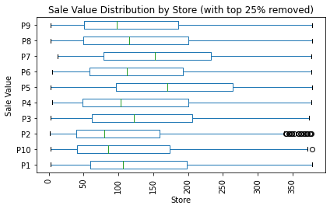
Figures - Sale Value by Store
Notes:
Francis
Store 5
Store 7
Store 3
Store 2 is only store with outline
Store 5 has the highest interquartile range

Slide 21
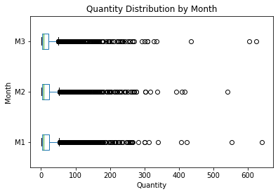
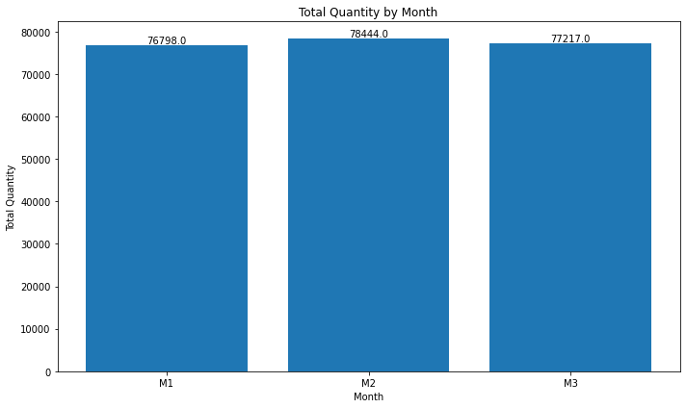
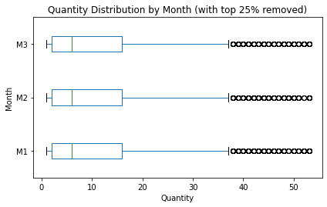
Figures - Order Quantity
Notes:
Francis

Slide 22
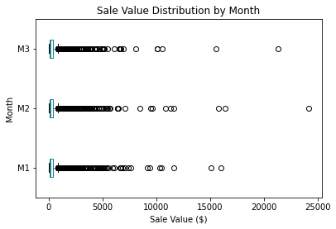
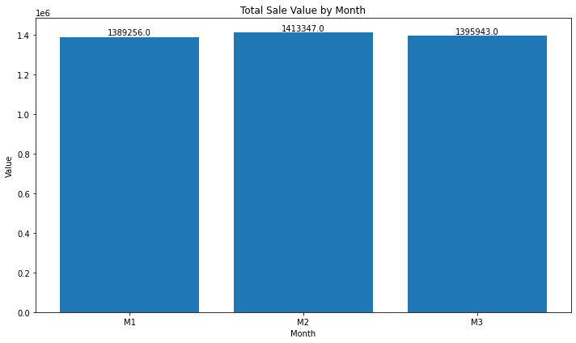
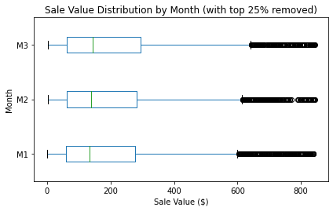
Figures - Sale Value
How are sales trending over time?
Notes:
Francis

Slide 23
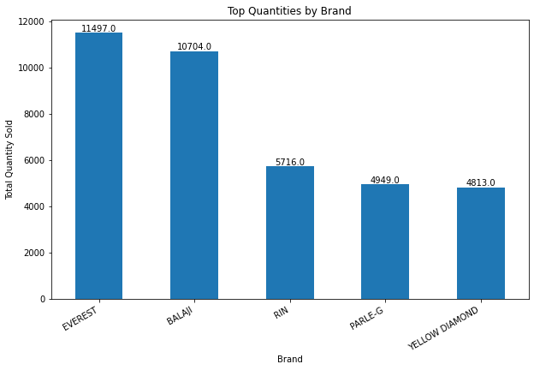
Figures - Cumulative
What are the top selling products?
Notes:
Pat

Slide 24
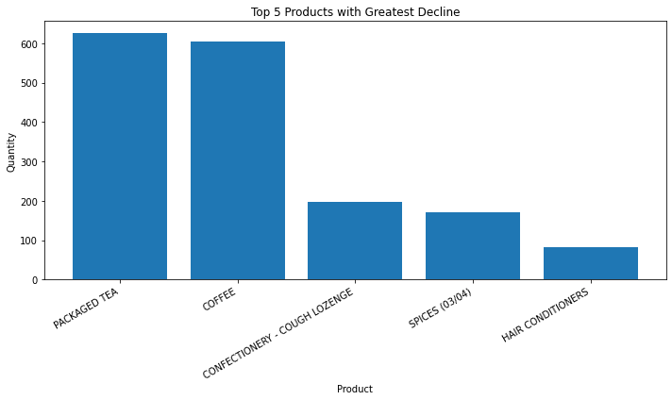
Figures - Cumulative
Which products have declining sales?
Notes:
Pat

Slide 25
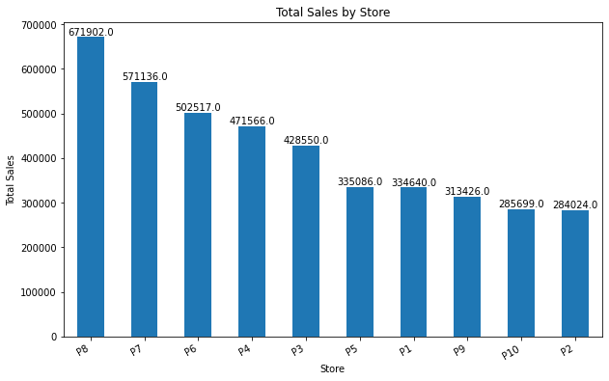
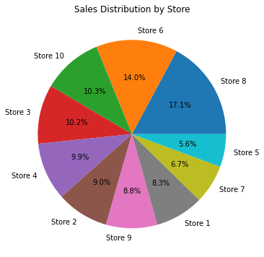
Figures - Cumulative
How do sales vary across different store locations?
Notes:
Pat

Slide 26
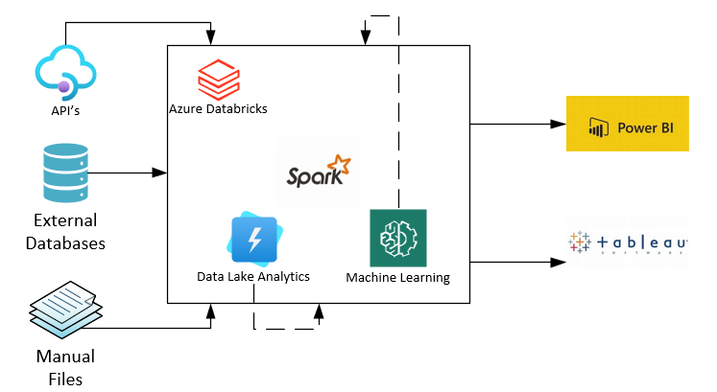
Business Implementation (Databricks Architecture Overview, n.d.)
Notes:
Pat

Slide 27
Visual Explanation
Azure Databricks: Databricks is implemented on the Azure platform, leveraging its powerful Spark computing service. Spark provides distributed computing capabilities, enabling businesses to process large-scale data workloads efficiently and at scale.
Datalake Analytics: Within Azure Databricks, businesses can leverage Datalake Analytics, which is powered by Spark. Datalake Analytics enables data engineers and data scientists to perform complex data analytics, transformations, and exploratory data analysis on their datasets. It provides the ability to process, clean, and transform raw data into meaningful insights.
Machine Learning: Azure Databricks supports machine learning capabilities, leveraging the power of Spark. Data scientists and analysts can build and train machine learning models using Spark's distributed computing capabilities. This empowers businesses to unlock the value hidden within their data and make data-driven predictions, classifications, and recommendations.
Incoming Sources:
Databricks can handle a variety of incoming data sources, including APIs, external databases, and manual files. This ensures flexibility in data ingestion and allows businesses to seamlessly integrate their data from various sources into Databricks.
Visualization:
Once the data is processed and insights are derived using Databricks, it can be visualized for better understanding and decision-making. Databricks integrates seamlessly with popular visualization tools such as Power BI and Tableau. These tools provide interactive and intuitive dashboards, charts, and reports to visualize the analyzed data and communicate insights effectively to stakeholders.
Notes:
Pat

Slide 28
Significance of Project
Decision-making and data analysis fields
Smoothly combine several programming languages including Python, PySpark, and SQL
Manage massive datasets in parallel - cut processing times
Interface with visualization tools like Tableau and PowerBI
Efficient and scalable ideal for managing big data analytics
Improve operational effectiveness, customer insights, and strategic decision-making
Notes:
Pat

Slide 29
Architecture – Data Ingestion (Enterprise Edition)
Assess Data Sources: Identify the different data sources you want to ingest into Databricks. This can include structured data from databases, semi-structured data from APIs or web services, unstructured data from files, or streaming data from real-time sources.
Understand Data Formats: Determine the formats in which the data is stored or transmitted. Common data formats include CSV, JSON, Avro, Parquet, ORC, and more. Understanding the data formats will help you choose the appropriate ingestion methods and processing techniques.
Choose Ingestion Methods: Databricks supports multiple ingestion methods depending on the data source and format. Some common ingestion methods include:
Batch Ingestion: Use batch processing to ingest large volumes of data in periodic intervals. You can leverage Databricks utilities like Apache Spark's data source APIs, Databricks Utilities (dbutils), or external libraries to read data from databases, file systems, or cloud storage.
Streaming Ingestion: If you have real-time data streams, you can use Databricks structured streaming capabilities to ingest and process data in near real-time. Spark Streaming provides built-in connectors for streaming sources like Apache Kafka, Azure Event Hubs, or Amazon Kinesis.
Data Connectors: Databricks offers various connectors and integrations with popular databases, data warehouses, and cloud storage systems. Leverage these connectors to directly ingest data from sources like Amazon S3, Azure Blob Storage, Apache Cassandra, or JDBC-compatible databases.
Custom Integrations: In cases where Databricks does not have direct integrations, you can build custom ingestion pipelines using programming languages like Python or Scala. Utilize appropriate libraries or frameworks for data extraction, transformation, and loading (ETL).
Data Ingestion Pipeline: Design an end-to-end data ingestion pipeline that incorporates data extraction, transformation, and loading processes. Identify the data flow, data transformations, data cleansing, and enrichment steps required for your specific use cases.

Slide 30
Architecture – Databricks (Enterprise Edition)
Workspace: The Databricks Workspace is a web-based interface where users can create and organize projects, notebooks, and libraries. It serves as a centralized hub for collaboration and enables teams to share and collaborate on data engineering and data science tasks.
Notebooks: Notebooks are interactive environments where users can write and execute code. Notebooks support multiple programming languages, including Python, Scala, R, and SQL. They allow for the integration of code, documentation, and visualizations, making it easy to develop, test, and share data-driven workflows.
Apache Spark Integration: Built on Apache Spark, an open-source distributed computing framework. Databricks provides a managed Spark cluster that can scale up or down based on workload requirements. Users can leverage the power of Spark for big data processing, data transformations, machine learning, and real-time analytics.
Collaborative Features: Enables seamless collaboration among team members. Multiple users can work on the same notebook simultaneously, making it easier to share ideas, collaborate on code, and review each other's work. Users can also provide comments and feedback within notebooks, enhancing teamwork and knowledge sharing.
Data Exploration and Visualization: Provides rich data exploration and visualization capabilities. Users can easily connect to various data sources, perform exploratory data analysis, and create visualizations using libraries like Matplotlib, Seaborn, and Plotly. The interactive visualizations help users gain insights from data and communicate findings effectively.

Slide 31
Architecture – Databricks (Enterprise Edition) cont’d
Job Scheduling: Allows users to schedule and automate the execution of notebooks and jobs. Users can set up recurring jobs to perform data processing, model training, or data pipeline orchestration. Job scheduling helps streamline workflows, increase efficiency, and reduce manual intervention.
Data Access and Integration: Integrates with various data sources and systems, making it easy to ingest and process data. It provides connectors to popular data storage solutions like Amazon S3, Azure Blob Storage, Hadoop Distributed File System (HDFS), and databases such as Apache Cassandra and JDBC-compatible databases. Databricks also supports streaming data sources like Apache Kafka and cloud-based event hubs.
Machine Learning Support: Offers extensive support for machine learning workflows. It provides pre-installed libraries like scikit-learn, TensorFlow, PyTorch, and XGBoost, enabling users to build and deploy machine learning models. Databricks also offers a powerful AutoML toolkit, MLflow for experiment tracking, and model deployment capabilities.
Security and Governance: Ensures data security and governance through features like role-based access control (RBAC), fine-grained access permissions, and integration with identity providers like Active Directory and Single Sign-On (SSO). It supports encryption at rest and in transit, providing a secure environment for sensitive data processing.
Scalability and Performance: Offers a scalable and highly available infrastructure. It automatically scales the underlying Spark cluster based on workload demands, allowing users to handle large datasets and complex analytics tasks efficiently. Databricks also optimizes Spark's performance with features like caching, data skipping, and query optimization.

Slide 32
Architecture -- Visualization (Enterprise Edition)
Interactive Visualizations: Provides interactive and dynamic visualizations that allow users to explore and analyze data. Users can create charts, graphs, and plots using popular visualization libraries like Matplotlib, Seaborn, and Plotly. These visualizations can be customized and manipulated in real-time, enabling users to gain deeper insights and uncover patterns in the data.
Rich Charting Options: Offers a wide range of charting options to effectively represent data. Users can create bar charts, line charts, scatter plots, histograms, heatmaps, and more. These charts can be customized with various attributes like colors, labels, legends, and axes, providing flexibility in visualizing different types of data.
Dashboard Creation: Allows users to create interactive dashboards to present data and insights in a concise and visually appealing manner. Users can combine multiple visualizations, charts, and tables into a single dashboard, making it easier to convey complex information and share key findings with stakeholders. Dashboards can be shared with others and accessed through a web-based interface.
Geospatial Visualization: Supports geospatial data visualization, enabling users to plot and analyze data on maps. Geospatial visualizations can be used to display location-based data, perform spatial analysis, and identify patterns or trends in geographic data. Users can create choropleth maps, point maps, heatmaps, and other geospatial visualizations to visualize data in a spatial context.
Interactive Widgets: Allows users to create interactive widgets and controls that enhance the interactivity of visualizations. Users can add sliders, dropdown menus, checkboxes, and other interactive elements to their notebooks or dashboards. These widgets enable users to dynamically update visualizations based on user inputs or filter data interactively, enhancing the exploration and understanding of data.
Integration with BI Tools: Integrates with popular Business Intelligence (BI) tools like Power BI and Tableau, allowing users to seamlessly connect their Databricks environment with these tools for advanced visualization capabilities. Users can leverage the powerful data transformation and analysis capabilities of Databricks and then create rich, interactive dashboards and reports using BI tools, providing a seamless end-to-end data analysis and visualization workflow.

Slide 33
Databricks Community Edition -- Limitations
Storage Capabilities: Storage capacity is limited to a certain quota. The specific storage limit varies depending on the version and provider of the Community Edition. For example, the free tier of Databricks on Azure may have a limit of 5 GB or 10 GB of storage. Memory is also limited for allocation of tasks and computations
Compute Resources: Limited on the available compute resources, which includes the number of virtual machines (VMs) or nodes that can be used for processing your data and running computations. The number of compute resources is limited to a certain threshold, which can impact the scalability and speed of your data processing tasks. This means that you may experience slower execution times or limitations on the size and complexity of the data you can handle.
Data Retention: Limited data retention period, which means that data stored in Databricks may be automatically deleted after a certain period of time. This can impact long-term data analysis or historical trend analysis.
Integrations: Has restrictions on integrating with certain external services and platforms. This can limit the ability to connect and integrate with specific data sources, tools, or services required for your workflows.
Concurrency: Number of concurrent notebooks, jobs, clusters that can be executed simultaneously, unable to run multiple tasks or analyses concurrently. Nodes (Connections to Notebooks =) are limited to 2 hour working sessions. Notebooks must be published and shared for continued use amongst group members.

Slide 34
Lessons Learned
Databricks capabilities
Parquet format
Collaboration
Well thought out interface
Mixed data structure types
Ability to use multiple programming languages
Notes:
Pat

Slide 35
References
Store Transaction data | Kaggle. (n.d.). Retrieved May 4, 2023, from https://www.kaggle.com/datasets/iamprateek/store-transaction-data
Fernández Eva Patricia. (2017). Big data. Amazon. Retrieved May 1, 2023, from https://aws.amazon.com/big-data/datalakes-and-analytics/what-is-a-data-lake/
Introduction to data lakes. Databricks. (n.d.). Retrieved May 1, 2023, from https://www.databricks.com/discover/data-lakes
What is Databricks? | Databricks on AWS. (n.d.). Retrieved May 4, 2023, from https://docs.databricks.com/introduction/index.html
Exploratory data analysis on Databricks: Tools and techniques | Databricks on AWS. (n.d.). Retrieved May 4, 2023, from https://docs.databricks.com/exploratory-data-analysis/index.html
Tutorial: Delta Lake | Databricks on AWS. (n.d.). Retrieved May 4, 2023, from https://docs.databricks.com/delta/tutorial.html#read
What is Apache Parquet? (n.d.). Databricks. https://www.databricks.com/glossary/what-is-parquet#:~:text=What%20is%20Parquet%3F
Databricks architecture overview. (n.d.). Databricks Architecture Overview | Databricks on AWS. https://docs.databricks.com
Notes:
Pat

Slide 36
Thank You
Notes:
Pat

